Slide 1
Analyzing Word Frequencies in Python.org HTML
Processing Text Data from "python_website_data.txt"

Slide 2
The purpose of the code is to analyze the word frequencies in the HTML content of the Python.org website
The code contributes to understanding the textual characteristics of the HTML content, revealing insights that can inform content-related decisions and facilitate more advanced analyses.
The code reads the HTML content from the text file.
Punctuation is removed from the text, and all text is converted to lowercase. This is done to ensure uniformity and improve the accuracy of word frequency analysis.
The cleaned text is then split into individual words.
Analyzing word frequencies provides insights into the distribution of words, highlighting common terms and potential keywords present in the content.

Slide 3


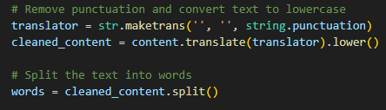
Code Overview
We are using the library and import the counter and string.
Read the text file.
Remove the punctuation and split the word for accuracy.

Slide 4
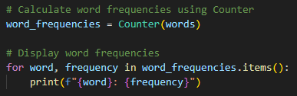
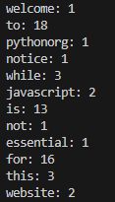
Calculate the word frequency and display
Calculate the word frequency with the counter and display.
Display the word with the continuity.

Slide 5
How to work the code?
Check the below how to work the code for check the word frequency with the continuity.
Import statements (Counter from collections and string).
Reading the content from the text file.
Removing punctuation and converting text to lowercase.
Splitting the text into words.
Calculating word frequencies using Counter.
Read Text File → Clean Text → Split into Words → Calculate Word Frequencies → Display Word Frequencies.

Slide 6
Conclusion
The code facilitates a deeper understanding of the textual content by revealing patterns and trends in the distribution of words within the HTML content of the Python.org website.
The code reads the HTML content from the text file, 'python_website_data.txt'.
Punctuation is removed from the text, and all text is converted to lowercase. This ensures uniformity in word analysis.
The output of the code displays each word along with its frequency, providing insights into the distribution of terms within the HTML content.

